Slide 1
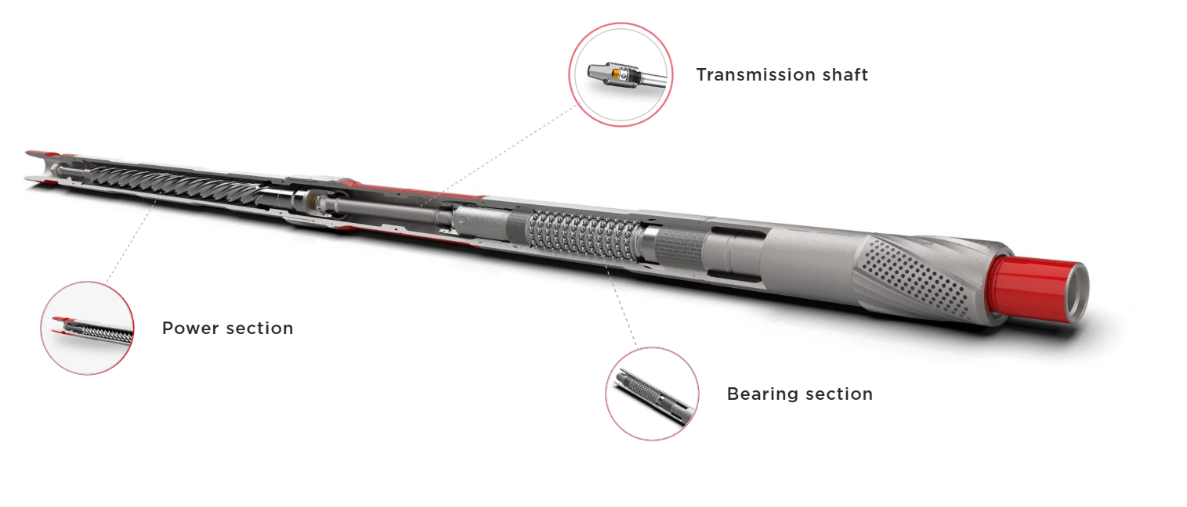
Welcome to the 7” Drillex Mud Motor Services

Slide 2
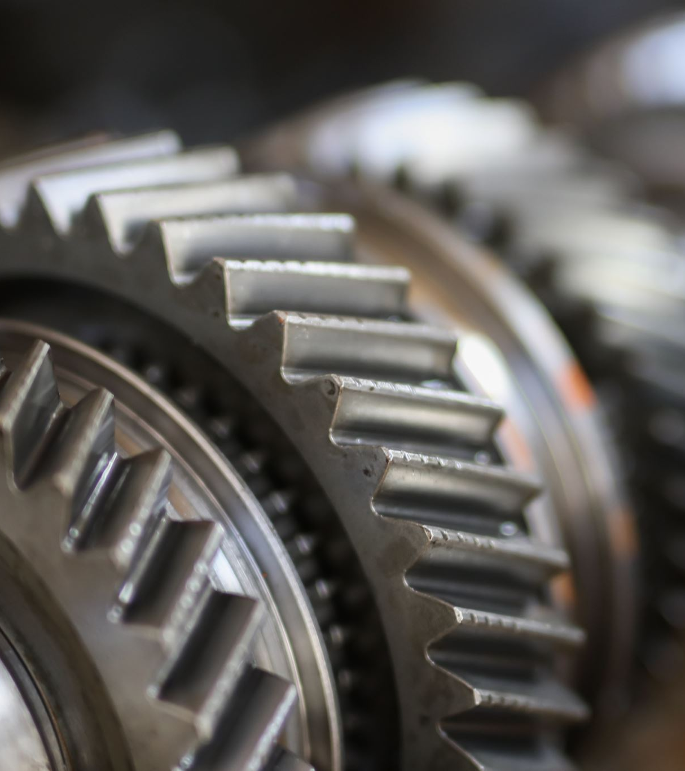
Overview
Mud motors, also known as positive displacement motors (PDMs), are essential tools in directional drilling operations. For 7-inch borehole applications, the Drillex Mud Motor is prominent tools known for their durability, efficiency, and directional control.

Slide 3
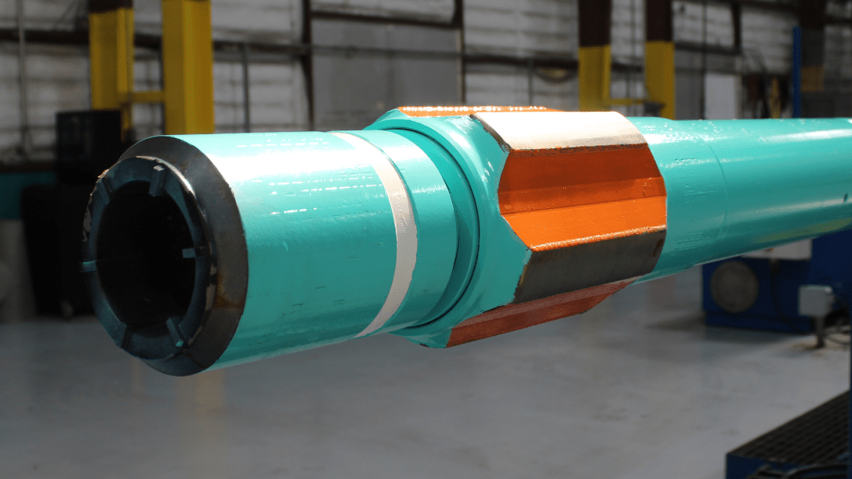
Drillex Mud Motor (7")

Slide 4
Manufacturer Overview
Drillex Tools is a globally recognized manufacturer of high-performance downhole drilling equipment specializing in high-performance mud motors engineered for large-diameter boreholes and demanding downhole conditions in oil, gas, and geothermal drilling in designing and engineering premium-grade Positive Displacement Motors (PDMs), power sections, and other drilling components used extensively in both conventional and unconventional well operations.
The 7-inch Drillex Mud Motor is engineered to deliver superior power, torque, and durability for large-diameter borehole drilling operations. Designed for challenging environments, Drillex 7" mud motor is favored in oil and gas, geothermal, and deep directional drilling where performance and reliability are paramount.

Slide 5
Mechanical and Design Features of the 7” Drillex Mud Motor
Power Section
Precision-engineered rotor-stator assembly optimized for maximum torque and durability to meet the demands of large borehole drilling.
Utilizes high-performance elastomers designed to resist extreme temperatures (up to 200°C) and aggressive chemical exposure typical in HPHT wells.
Lobe configurations (typically 6:7 or 7:8) tailored to balance torque output and rotational speed, optimizing drilling efficiency.

Slide 6
Bearing Assembly
Equipped with a robust, sealed bearing pack featuring premium-grade carbide radial and thrust bearings capable of sustaining heavy axial and radial loads typical for 7" operations.
Adjustable Bent Housing (ABH)
Provides an adjustable bend angle ranging from 0° up to 3°, allowing precise steering and tight-radius curve construction in directional wells.
Motor Length and Modularity
Designed with a modular architecture for ease of field maintenance, allowing quick disassembly and replacement of components.
Available in both mud-lubricated and oil-filled sealed configurations to suit different downhole environments and operator preferences.
Features a short bit-to-bend distance to enable rapid build rates and enhanced directional control.
The motor length is optimized to provide balance between durability and operational flexibility in complex well paths.

Slide 7
Design Features
High-torque performance enabled by an advanced rotor-stator assembly optimized for 7-inch size applications.
Adjustable bent housing providing variable bend angles typically ranging from 0° to 3.5°, allowing precise directional control and tight-radius build capability.
Premium high-temperature elastomers engineered to withstand HPHT environments up to 200°C (392°F).
Short bit-to-bend distance designed for enhanced steering accuracy and rapid build rates in complex well trajectories.
Robust bearing assemblies featuring carbide radial and thrust bearings for increased durability in abrasive and high-load formations.
Optional Enhancements & Add-Ons
Integration with MWD/LWD tools for real-time drilling data acquisition.
Anti-drop subs (ADS) and shock absorber modules for improved BHA stability.
Flow diverters and custom mud ports designed to optimize fluid circulation and cooling.
Suited for deep oil and gas wells, geothermal drilling, and extended reach drilling (ERD) projects.
Designed for abrasive and hard rock formations, including carbonates, sandstone, and conglomerates.
Effective in HPHT wells exceeding 200°C and high downhole pressures.

Slide 8
Operational Capabilities and Advantages
Performance in High-Demand Environments
Ideal for deep, high-angle, and horizontal wells requiring high torque and stable operation.
Designed to withstand high WOB and downhole pressure, delivering consistent ROP even in hard rock formations.
Drilling Efficiency
Enhanced elastomers and bearing designs reduce wear and extend run life.
Reduced vibration and improved torque delivery protect drill bits and associated downhole equipment.
Versatility
Compatible with a wide variety of bit types including PDC, tricone, and hybrid cutters.
Operates efficiently across a broad range of drilling fluids and flow rates suitable for large rigs.
Durability & Maintenance
Drillex motors are engineered for longer downhole life, reducing NPT (Non-Productive Time).
Components are field-repairable, with full support for spare parts and service kits.

Slide 9
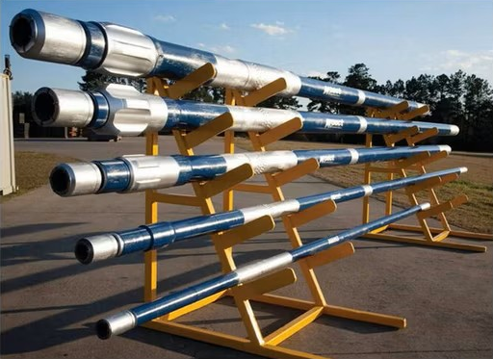
Drillex Mud Motor (7")

Slide 10
Manufacturer Overview
Drillex HDD designs reliable, cost-effective mud motors optimized for horizontal directional drilling (HDD) and mid-depth oilfield applications.
The 7-inch Drillex Mud Motor delivers a balance of performance and affordability for larger borehole drilling projects.
Drillex focuses on streamlined designs, ease of maintenance, and field versatility, which makes our 7-inch mud motors especially attractive to contractors seeking high performance with minimal downtime and cost overhead. Their 7-inch Drillex Mud Motor caters to larger borehole drilling operations where moderate torque and ease of maintenance are essential.

Slide 11
Mechanical and Design Features of the 7” Drillex Mud Motor
Power Section
Available in standard and high-torque elastomer configurations, designed to accommodate a variety of drilling environments.
Rotor-stator lobe ratios typically include 6:7 and 7:8, optimized for torque and speed suited to HDD and shallow directional wells.
Engineered for moderate RPM and torque performance tailored to soft to medium-hard formations.

Slide 12
Bearing Assembly
Offered in sealed bearing pack and mud-lubricated configurations, allowing operators to choose based on application specifics.
Bent Housing Design
Both fixed and adjustable bent housings are available with bend angles up to 2.5°, facilitating effective directional control for curve build and hold sections.
Motor Length and Compatibility
Compact design allows use in rigs with limited floor space and supports easy BHA assembly.
Bearings are modular and field-replaceable, ensuring quick maintenance and reduced operational downtime.
Bent housing design ensures smooth, controlled trajectory changes during drilling.
Compatible with standard HDD steering tools and many oilfield MWD systems for telemetry integration.

Slide 13
Design Features
High-performance elastomer compatibility engineered for durability with various drilling fluid types, including abrasive and high-temperature muds.
Optimized power section providing an efficient torque-to-speed ratio suitable for 7-inch drilling operations in soft to medium-hard formations.
Choice of sealed or mud-lubricated bearing assemblies offering flexibility based on application requirements and ease of maintenance.
Adjustable bent housing available with bend angles up to 2.5°, enabling precise steering control in horizontal and directional drilling.
Modular design allowing quick field servicing and part replacement to minimize downtime.
Steering tool housings for wireline or walk-over guidance systems.
Shock subs and vibration dampeners for extended tool and bit longevity.
Compatible with downhole transmitters for HDD navigation.
Multiple bit box configurations (API, IF) to interface with various drill bits.
Suitable for large-scale HDD projects including pipeline and conduit installations.
Appropriate for mid-depth directional oil wells and civil infrastructure drilling requiring moderate torque.
Ideal when cost-effective, reliable motors are preferred without sacrificing operational flexibility.

Slide 14
Operational Capabilities and Advantages
Optimized for HDD and Mid-Depth Drilling
Particularly suitable for utility installations, pipeline crossings, and mid-depth directional oil wells.
Performs well in soft to medium-hard formations such as clay, sand, gravel, and unconsolidated soils.
Ease of Maintenance and Cost Efficiency
Designed for quick rebuilds with commonly available parts and minimal specialized tools.
Reduces total cost of ownership by minimizing downtime and service complexity.
Drilling Performance
Effective torque delivery balanced with flow rates typically found in medium to large rigs (80–250 GPM).
Provides reliable performance in a broad range of drilling fluid systems.
Durability
Hardened housings and protective coatings resist abrasion and prolong tool life.
Seals and internal components protect against premature wear from drilling fluid contaminants.

Slide 15
Comparative Summary
Feature | Drillex Mud Motor (7") | Drillex Mud Motor (7")
Build Rate Capability | High (up to 3.5°/100 ft) | Moderate (up to 2.5°/100 ft)
Torque Output | Very High | Moderate
Durability | Superior, ideal for HPHT & abrasive formations | Good, with abrasion-resistant coatings
Typical Applications | Deep wells, HPHT, hard rock | HDD, mid-depth oilfield, utilities
Maintenance Complexity | Moderate, field-serviceable | Easy, fast rebuild
Cost | Higher upfront investment | More economical

Slide 16
Conclusion
The 7-inch Drillex Mud Motor is engineered for high-performance, demanding drilling environments, offering unmatched torque, durability, and precise steering control in deep, HPHT, and abrasive formations.
The 7-inch Drillex Mud Motor provides a cost-effective, reliable solution for HDD and mid-depth directional drilling, balancing performance with ease of maintenance and affordability.

Slide 17
Thank You For Staying With Us
Have A Nice Day and Work Safe

